Slide 1
pension Management System
By : M.S.Deekshita​
Emp Id : 2174986

Slide 2
Table of contents
1.Introduction
2.Functionality
3. Methods
4.Architecture
5.Procedure
6.Dockerization
7.Requirements
8.Advantages
9.Conclusion

Slide 3
Introduction
A pension is a retirement plan that provides a monthly income.
The employer bears all of the risk and responsibility for funding the plan.
The purpose of this application is to build a system that gives employees or employer various functionality for their pension management system.
This application includes various functions like create applicant , check status , check balance ,check application, Issue pension ,load pension using spring boot framework , Sql , Docker etc.

Slide 4
Functionality
1.Create Applicant(Pensioner)
2.Give details(id , name , age , balance , mobile, empstatus , pensionStatus , pensionmmyy , installment)
3.View Pensioner Records
By Check status , check balance , check applicant
4.Calculate Pension Using
.Load Pension
.Issue Pension

Slide 5
Methods
Create Applicant
Check Status(by id)
Check Balance(by id)
Check Application(by id)
Issue Pension
Load Pension

Slide 6
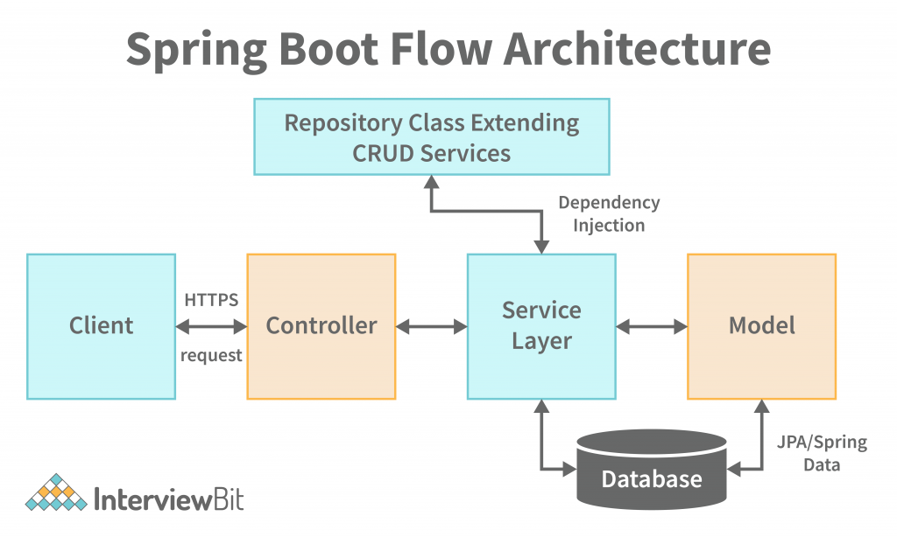
Architecture

Slide 7
procedure
Create Application structure using Spring Intializer by adding requirement, dependency and versions.
Write required classes and methods.
We have to install all the dependencies by doing mvn clean install.
Start mysql image in docker using docker-compose -f dockercompose-mysql.yml up –d
Then we need to run the application using the command mvn spring-boot:run
Then do mvn install dockerfile:build.
Now enter the data in postman using localhost:/port no/method name.

Slide 8
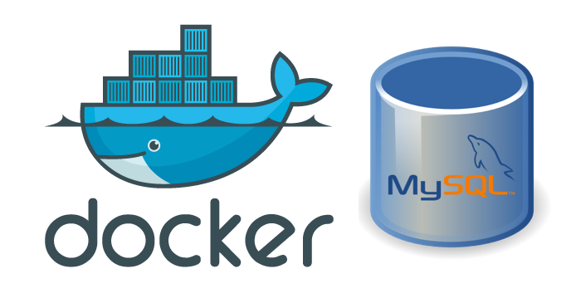
dockerization
Docker is an open source platform that enables developers to build, deploy, run, update and manage containers.
Docker containers can run anywhere, However, Windows images can run only on Windows hosts and Linux images can run on Linux hosts

Slide 9
Dockerization steps
To dockerization we need Dockerfile in our application.
After that start docker from docker desktop
Run command mvn install dockerfile:build
Check docker desktop weather image is created or not
Push to docker hub from docker desktop.

Slide 10
requirements
Software Requirements
Java Spring-boot
Postman
MySQL
Maven Docker
IDE(IntelliJ/Eclipse)
Hardware Requirements :
Windows OS
VM
Internet

Slide 11
adnantages
Easy to use/User friendly
database helps to minimize data redundancy.
User can easily perform operations like add, update, search, delete the data from database.

Slide 12
Conclusion
This Pension Management System is designed to manage pension activities. It is beneficial to a pension management organization as well as employee.
The basic aim of carrying out this project is to develop a solution that will largely, help in the aspect of pension management which would help eliminate the problems associated with the manual process .It helps to

Slide 13
Thank you

